Slide 1
Bowers Lane Affordable Housing Project
December 6, 2022
Notes:
Introduction of Professionals
Purpose of meeting: We know this has been a contentious land use topic in this Town for many years. We have spent many months developing alternative redevelopment options for the Post Office Plaza Redevelopment Area which include the minimum number of affordable housing units required.
We would like to present the final options for consideration tonight, answer any questions and begin to hear your feedback on the options. The next town hall meeting next week is devoted to the continuation of hearing your feedback.
Tonight – I will be the main presenter but ask my colleagues to chime in when they need to add anything that I may miss. All of us will be available for questions. I request that all questions/comments be held by the public until the end.
We truly appreciate your understanding and patience in this process.
The presentation will be available on the website for viewing.

Slide 2
Meeting Overview
Introduction + Meeting Format
Background – Affordable Housing + PO Plaza Redevelopment
Bergen County United Way (BCUW) Project
Background
Precedent Projects
Bowers Lane Project Preliminary Plans
Next Steps
Questions
Notes:
Background
General history of AH in Borough
PO Plaza Redevelopment Area original goals/objectives and existing standards
Redevelopment Options – alternative development options based upon certain criteria that was utilized to determine the final options for consideration / review the ownership of the parcels within the PO Redevelopment Area / talk about the ability to use the Post Office property / briefly touch on the M-A program / Go over 5 options and then provide a comparison matrix table / talk about what happens in the next 6 months to 1 year broadly and then open it open to questions/feedback

Slide 3
The Obligation
Rehab.
0
Prior Round
(1987-1999)
23 RDP
54
Unmet Need
77
Third Round
(1999-2025)
71 RDP
337
266
Unmet Need
Notes:
Obligation – as calculated from Mercer decision

Slide 4
Satisfying the Obligation: Third Round RDP
2021 Third Round: 71
Extension of Controls: 8 units
Inclusionary & Redevelopment Sites: 48-52 units
17-37 Bowers Lane (AFD-4)
4 Watchung Avenue
River Road Redevelopment Area (Lots 9, 10, 11 &12): 37 units
Rental Bonuses: 17 credits
Total: 73-77 credits
Notes:
Challenge
Meet obligation with
Conforming to the overall land planning goals and objectives in mind (limit sprawl development, ensure neighborhood compatibility, locate AH near services and transportation) without significantly changing the character of the Borough
Take advantage of redevelopment/smart growth opportunities where infrastructure can support it
Compliance Mechanisms –
-COAH rules regulate what gets and does not get credit
-Menu of options
-Each has benefits and challenges as well as constraints (regulations)

Slide 5
The Obligation
Rehab.
0
Prior Round
(1987-1999)
23 RDP
54
Unmet Need
77
Third Round
(1999-2025)
71 RDP
337
266
Unmet Need
Notes:
Obligation – as calculated from Mercer decision

Slide 6
Satisfying the Obligation: Unmet Need
Prior Round + Third Round: 320 units
AH set-aside requirement
M-1, M-3, B-2, B-4
Overlay Zoning
Gateway Overlay Districts 1 & 2
Mandatory Set Aside Ordinance
Redevelopment
100% AH Bowers Lane: 15 AH units
Gateway Overlay District: 75 AH units
Notes:
Challenge
Meet obligation with
Conforming to the overall land planning goals and objectives in mind (limit sprawl development, ensure neighborhood compatibility, locate AH near services and transportation) without significantly changing the character of the Borough
Take advantage of redevelopment/smart growth opportunities where infrastructure can support it
Compliance Mechanisms –
-COAH rules regulate what gets and does not get credit
-Menu of options
-Each has benefits and challenges as well as constraints (regulations)

Slide 7
Who Qualifies for Affordable Housing?
Based on 2022 Regional 2 Median Income in
Morris, Essex, Union & Warren Counties
Maximum Household Income
 | 1 Person | 2 Person | 3 Person | 4 Person
Median | $80,634 | $92,154 | $103,673 | $115,192
Moderate | $64,507 | $73,723 | $82,938 | $92,154
Low | $40,317 | $46,077 | $51,836 | $57,596
Very Low | $24,190 | $27,646 | $31,102 | $34,558
Notes:
Nurses aid – 25k
Registered nurse – 52k
SS counselor – 48k
Teacher – 55 – 56 (first 5 years of career)
Clerical – 30k
EMT – 43K

Slide 8
What is Affordable Housing?
Affordable Home Sales Prices (Illustrative Low to Moderate)
One-bedroom: $75,000 - $115,000
Two-bedroom: $91,000 - $138,000
Three-bedroom: $104,000 - $159,000
Affordable Rents (Illustrative Very Low to Moderate)
One-bedroom: $600 - $1,195
Two-bedroom: $1,090 - $1,430
Three-bedroom: $1,271 - $1,650

Slide 9
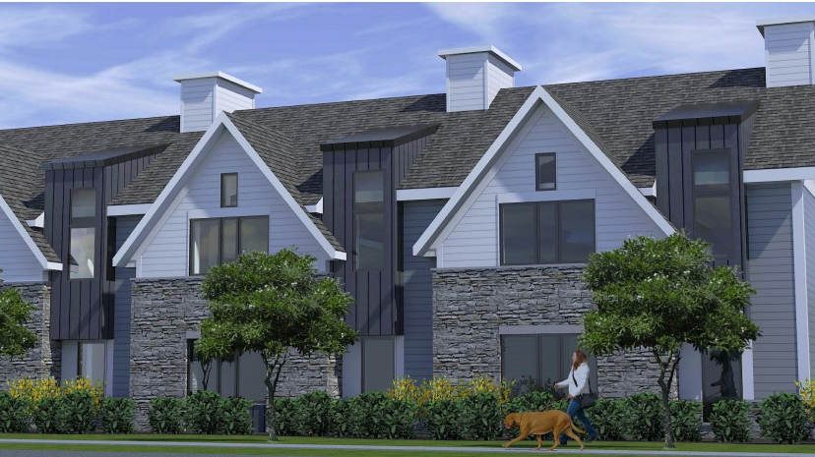
Municipally Sponsored: 100% Affordable Housing
What?
100% of units in project are affordable to low- and moderate- income families
Why?
Alternative to inclusionary housing
Benefits
Challenges
Concentration of AH units
Economies of scale: building and land area
Municipal partnership
Federal/State funding sources
Funding is not guaranteed
Municipal subsidy needed
Municipal commitment to fund any shortfall in funding

Slide 10
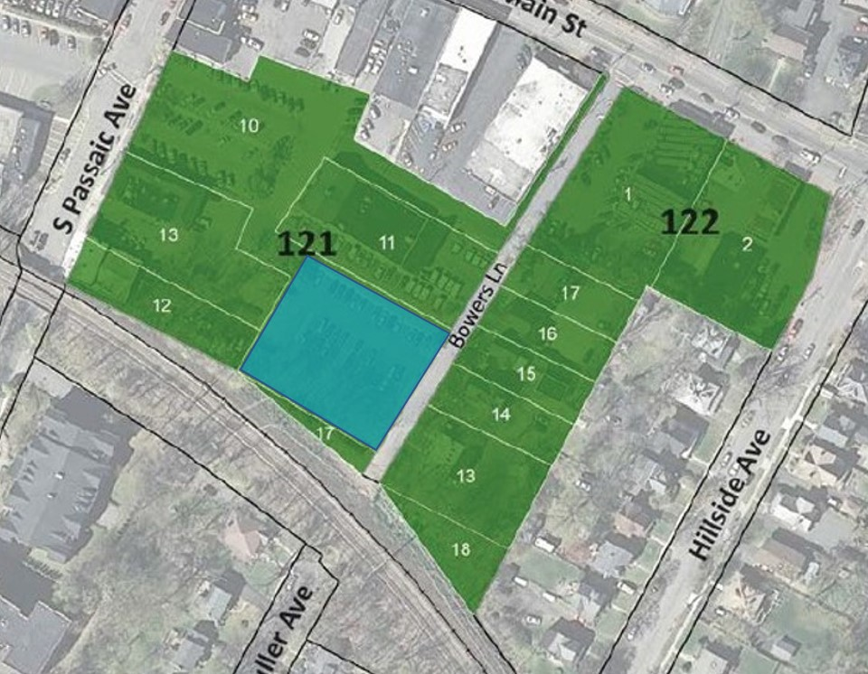
Bowers Lane (Restated Post Office Plaza) Redevelopment Plan
(15) 100% AH Family Units
Mix of bedrooms and income levels
0.55 Acres of Lot 10 (Borough owned)
Frontage/Access to Bowers Lane

Slide 11
BCUW Team
Tom Toronto, President
Mike Scro, Architect, Z+ Architects

Slide 12
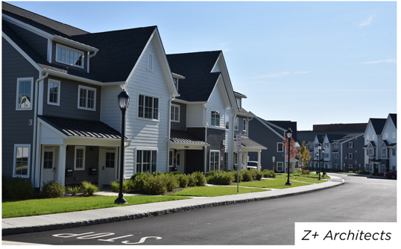
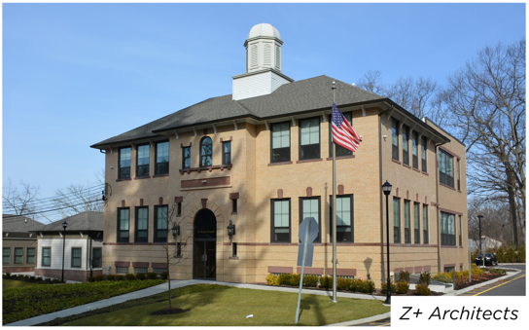
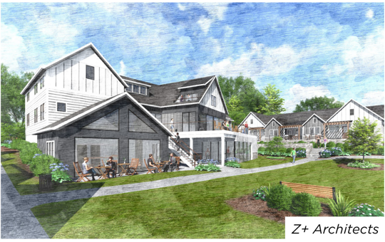

Slide 13
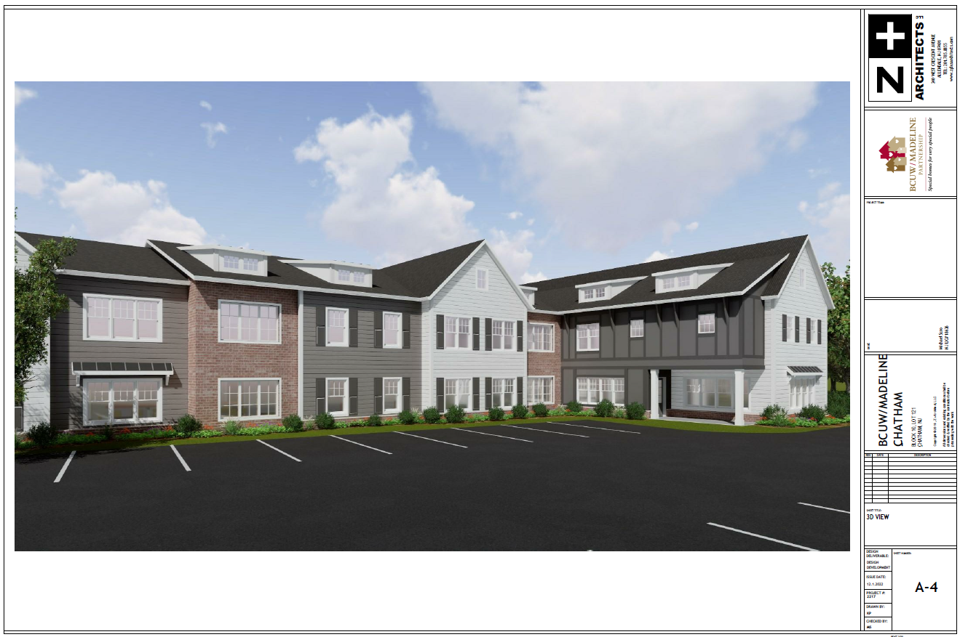

Slide 14
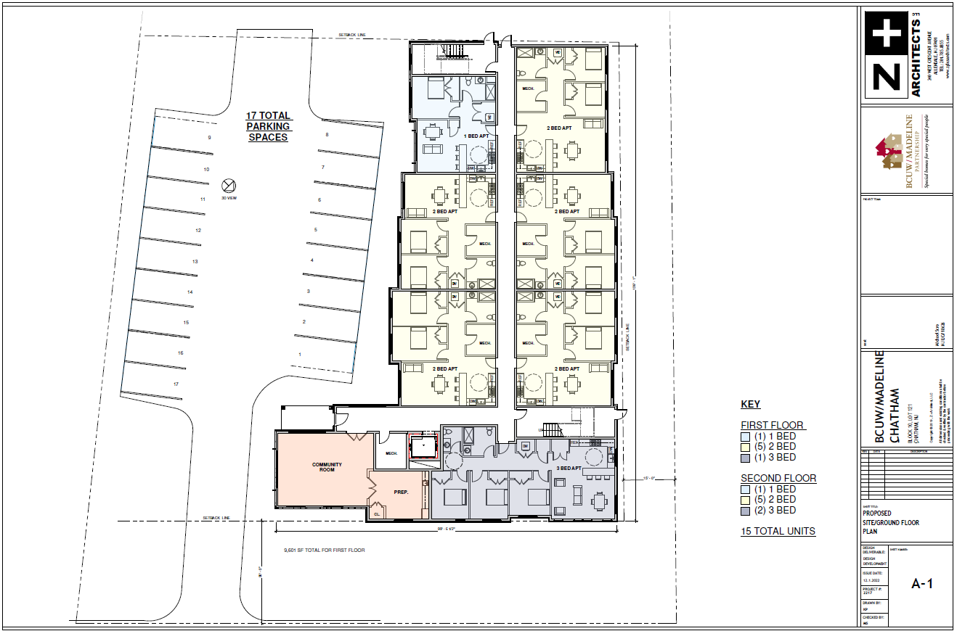

Slide 15
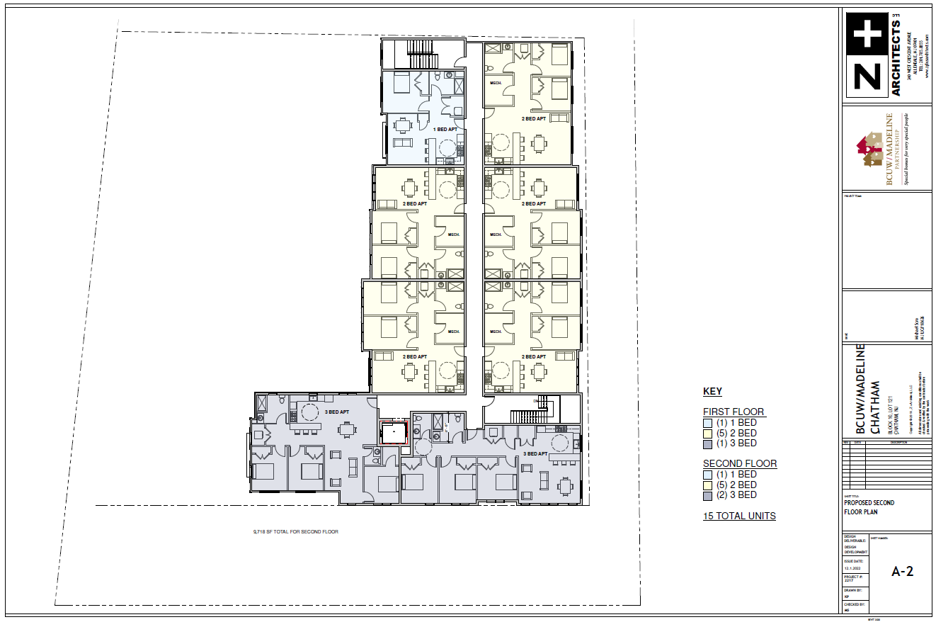

Slide 16
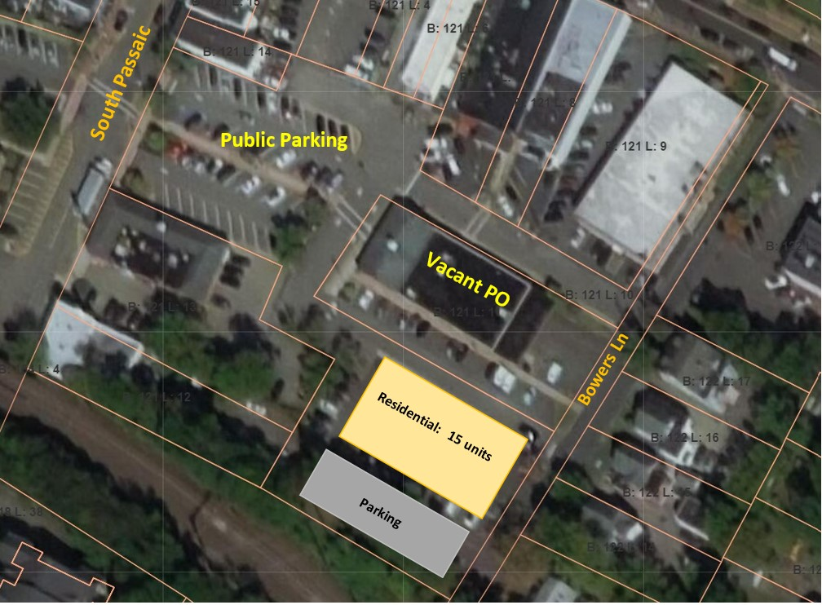
Bowers Lane Affordable Housing Project
Maintain approximately 59 parking spaces
Opportunity to upgrade public parking lot
Alternate parking opportunities

Slide 17
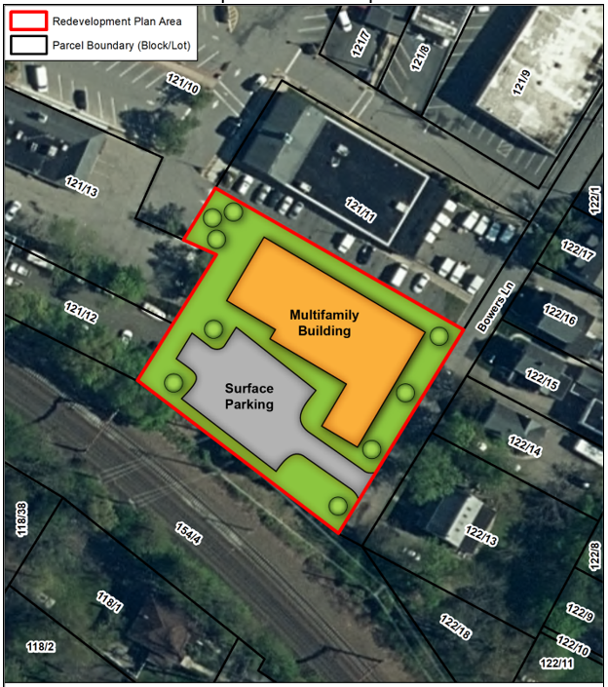
Next Steps * Finalize Site Plans and Architectural Plans * HPC & PB Application Submission: Feb. 2023 * PB Meetings: Spring 2023 * Funding Process: Winter 2023 * Construction Start: 2024- 2025 * Certificate of Occupancy: Mid-Late 2025
Notes:
Additional information may be found on the Borough website – past AH presentation and information session
Eight additional opportunities to provide your feedback on the future project

Slide 18
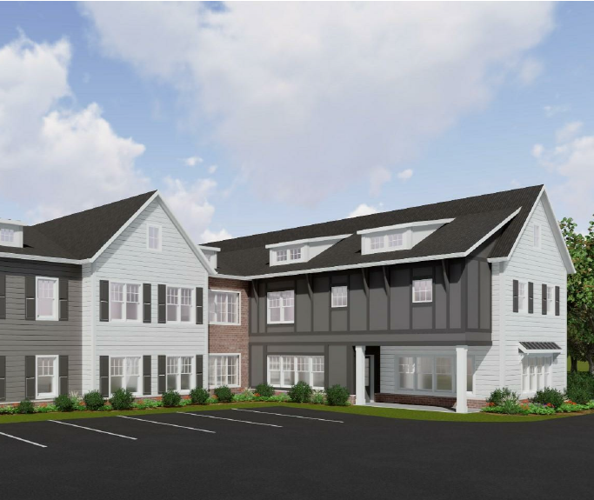
Questions

